Slide 1


MEX Assistant
Presented by Wi-Five

Slide 2



Table of Contents
Demo
Solution Architecture
1
2
Demo of the prototype
Architecture of the MEX Assistant

Slide 3



Demo

Slide 4

Solution Architecture

Slide 5
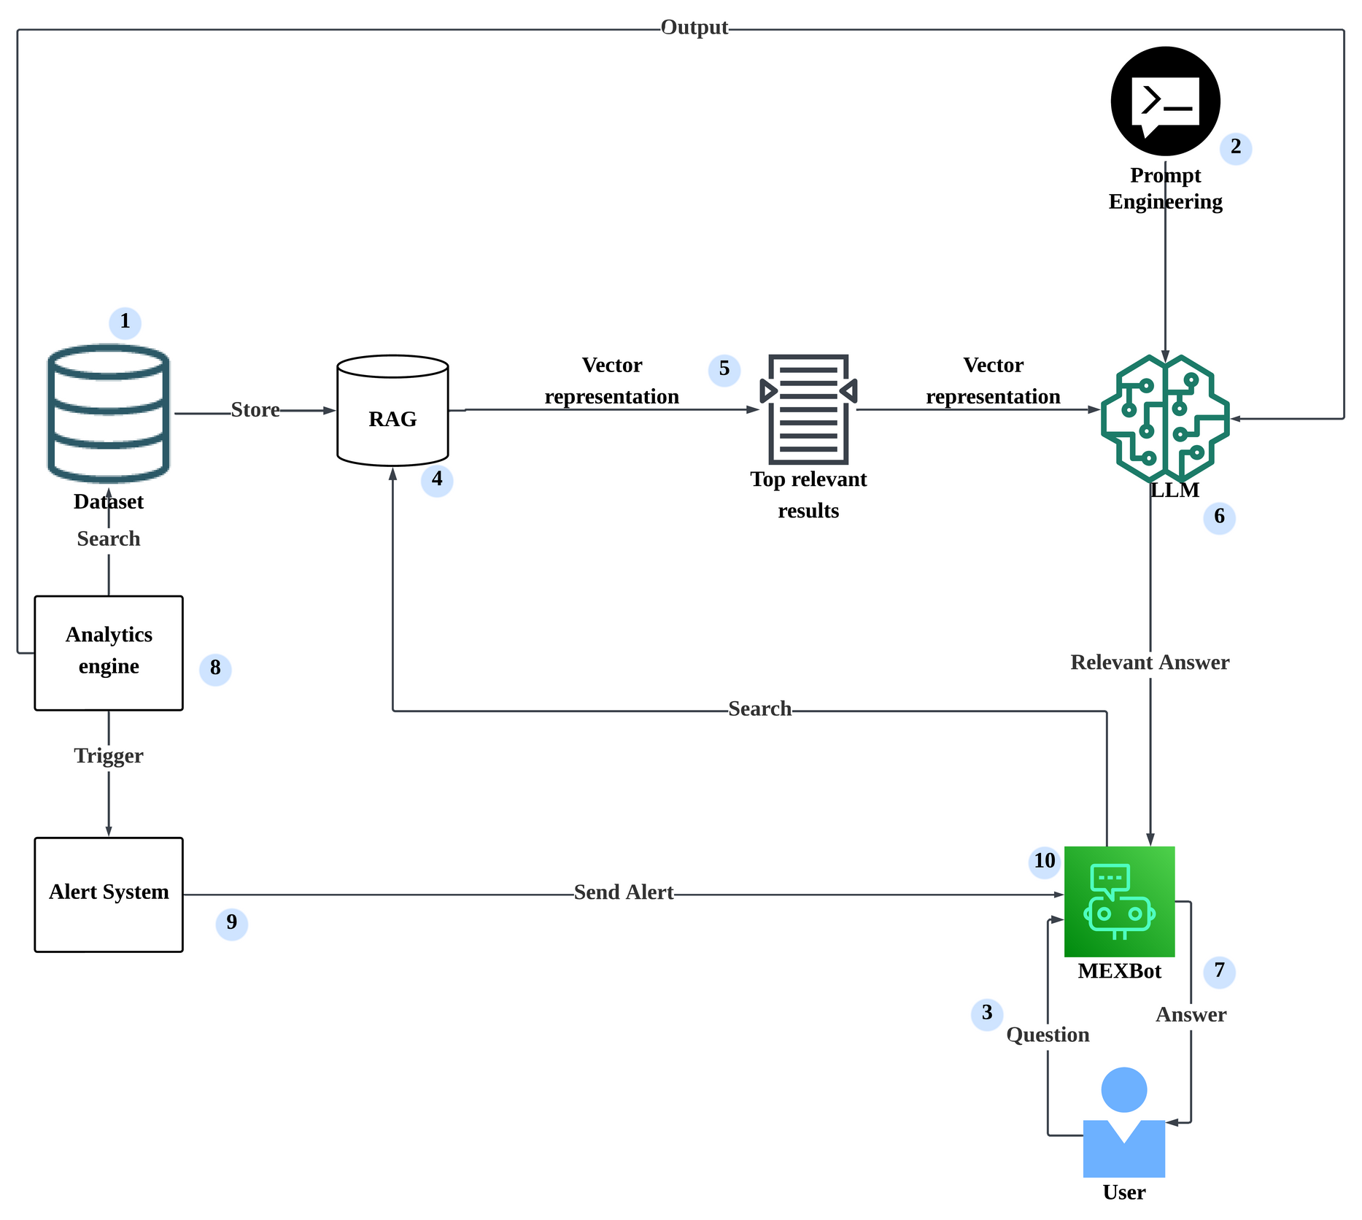

Architecture
Diagram
Stores data.
Prompt optimizes user queries.
User asks question to MEXBot.
Searches relevant info from the data.
Returns top relevant document.
LLM generates the answer.
MEXBot replies answer to user.
Monitors and analyzes data.
Sends alerts if triggered.
Alerts sent to MEXBot.

Slide 6


Technical Infrastructure
Concept 1
Concept 2
MEXBot's Intelligent Query Handling
Backend services and APIs used

Slide 7

Concept 1
MEXBot respond intelligently to user queries using datasets through two methods:
Retriever-Augmented Generation (RAG)
Large Language Model (LLM)

Slide 8
Concept 2
Backend services and APIs used
10 steps

Slide 9




Concept 2
1
Data Ingestion
The system ingests datasets including both structured (e.g., sales.csv, inventory.csv) and unstructured (e.g., merchant_guides.txt) data.
Structured data is used by the Analytics Engine.
Unstructured text is converted into vectors using an embedding model and stored in the RAG vector store for semantic retrieval.

Slide 10

Concept 2
2
3
Structured Prompt
User Query
A structured prompt that guides the LLM to generate focused and relevant responses.
The user asks a question through MEXBot, which forwards it to the backend for processing.

Slide 11

Concept 2
4
Semantic Query Handling
For semantic questions:
MEXBot sends the question to RAG.
RAG searches the vector store for relevant content.

Slide 12

Concept 2
5
RAG Retrieval
MEXBot sends the semantic query to RAG.
RAG performs a similarity search on the vector store.
Retrieves top matching document chunks relevant to the user’s query.
These chunks are used to construct the final prompt for the LLM.

Slide 13

Concept 2
6
LLM Processing
The prompt is sent to the LLM which generates a response.
7
Response Delivery
MEXBot receives the LLM’s answer and presents it clearly to the user.

Slide 14


Concept 2
8
Analytics Engine for Structured Queries
For structured questions:
The Analytics Engine processes CSV datasets (e.g., calculates KPIs: sales trends, inventory levels).
Runs periodically to monitor metrics.
If anomalies/threshold breaches are detected (e.g., low stock), results are passed to the Alert System → pushes notifications to MEXBot.

Slide 15

Concept 2
9
Alert System Activation
The Alert System is triggered by flagged outputs from the Analytics Engine.
When a KPI or threshold breach is detected:
Analytics Engine passes results to the Alert System.
Alert System pushes alerts to MEXBot.

Slide 16

Concept 2
10
MEXBot's Response and Intent Detection
MEXBot presents responses/alerts to users via chat interface:
Uses natural language and visual cues.
Uses Intent Detection classifies user queries into two types:
Structured Intent
Sent to the Analytics Engine for data-driven answers.
Open-ended/Semantic Intent
Sent to the RAG + LLM pipeline for more complex responses.
("What are my sales this week?")
("How can I improve delivery service?")

Slide 17


Thank you

